Slide 1
Jan. 12, 2021
We are new using zoom for our meetings so please be patient!
MUTE yourself if not already muted
Feel free to use the CHAT feature to talk to others (send to everyone) or ask questions

Slide 2
Agenda
7:00 – 7:30 PWRBA Business Meeting
7:30 – 8:30 ish Special Guest! Monica - Value Added Products Using Beeswax
8:45 ish - 9:00 Monica- A Brief Intro. to the Mission Believe Project

Slide 3
PWRBA Officers
Committees & More
President Jim Gehlsen
Vice President Ed Steele
Treasurer Sal Rivera
Secretary Rachel Dorsey
Bee School Principal Chris Mayes
Past President Erik Brown
Membership
NEW Jen Wease (Coordinator)
NEW George Ellis (Greeter/Outreach)
Swarm Call Jim G.
Website Coordinator Karla Eisen
Public Education & Outreach Coordinator
NEED SOMEONE HERE
Additional Board Members: Donna Shea, Gary Harris, & more

Slide 4
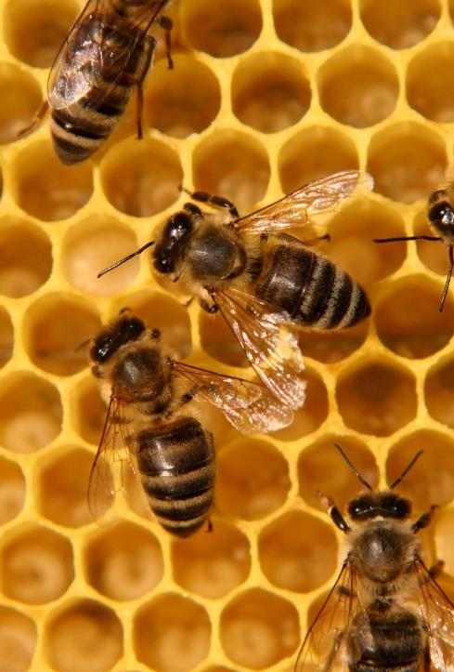
Welcome New Bees!
Share your name
Do you have bees?
Where do you live and/or keep bees?
Anything else?

Slide 5
Recent Events
April 2020: Nuc program Field Day
Thank You Jim G. & Chris M.!
Nucs & Splits
Free Queen to make a nuc

Slide 6
2020 Bee School Graduates
Ron Morales
Jim Fredericks
Dawn Johnston
George Ellis
Danielle Quick
Gregory Benson
Shane Neitzey
Michele White
Kuan Chen
Jade Kreissler
Kathie Buckley
Neil Peterman
Ed Champoux
Lisa Young
Brendan & Megan Rice
Paul Cocca
Toni Suits
Tony Jones
Richard Weinmann
Meysam Ali
Trey Easley
Josh Larosse
Erin Jones
Hamid Ghassemi
Christina Brooks
THANK YOU
BEE SCHOOL TEACHERS
Chris Mayes
Lynn Hewitt White
Ann Iseler
Karla Eisen
Bob Wellemeyer
Mike Blythe
John Strecker
Diana Graves

Slide 7
UPCOMING PWRBA Events March 9, 2021 Meeting
Swarms, Swarm Call & Catching Swarms
With Jim Gehlsen

Slide 8
More Upcoming Events
VSBA Speaker Series
Jan. 16th Dr. James Wilson
Feb. 3rd Detroit Hives- The Place to Bee
Feb. 15th Toni Burhnam- Challenges of Urban Beekeeping
VSBA programmed through early April- See www.virginiabeekeepers.org
ApiSolutions Consortium
Feb. 10th Making Healing Exliers For You & Your Honey
EAS Short Course & Conference – TBD virtual event, but NOT LIVE in MA

Slide 9
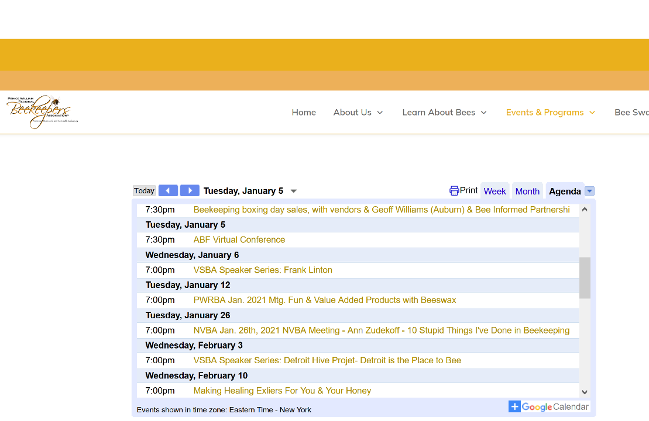

Slide 10
Bee School Update
NO INTRODUCTION TO BEEKEEPING “BEE SCHOOL” IN 2021
Online classes available are posted on website (including other VA beekeeping teacher consortium zoom classes)
NEW- PWRBA 2021 Refresher Class (Taught via zoom)
Open to PWRBA members who have had bees at least one year (2020 Graduates welcome)
Pre-Registration Required- Encourage commitment to attend Sessions 1-4
Class Sessions- Starting in February:
1. Winter into Spring Management Part 1
2. Winter into Spring Management Part 2
3. Keeping Healthy Hives (pest & disease assessment & treatment)
4. Nucs and Splits
Honey Harvest (TBD- Live honey harvest demonstrations in June/July)

Slide 11
PWRBA Membership
Electronic Membership and Renewals
Visit www.pwrbeekeepers.com, click on Become a Member
Join as Member ($20)
Credit cards only
Create Member account (username and password) to access Members Only on Website
Rolling renewals (renew 12 months after dues paid, no matter when you join)
Bee School Students get free membership
Can register on paper
Forms on Website
2021 Membership Dues Proposal
Discussion
VOTE (hopefully by zoom poll)

